Slide 1
Genome-Wide Association Studies (GWAS)
GWAS 1: Case-Control Association Testing
GWAS2: Quantitative Traits
11 & 18 August 2023
Phuc-Loi Luu, PhD
Loi.lp@pacificinformatics.com.vn
luuphucloi@ump.edu.vn

Slide 2





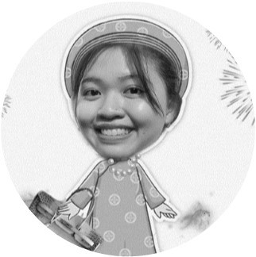





The Bioinformatics Team Members
Name and Role | Profile Picture | Profile Picture | Name and Role
Luu Phuc-Loi, PhD Team Lead |  |  | Nguyen Viet Tuan, PhD Consultant
Du Hoang Tien, Msc. Associate |  |  | Phan Vo Thu Nga, Bsc. Associate
Nguyen Le Duc Minh, Dr. Genetics Consultant |  |  | Tran Thien Tan, Bsc. Technician
Dao Khuong Duy, Bsc. Technician Nguyen Minh Hoang, Bsc. Technician |  |  | Le Van Hieu, Bsc. Technician

Slide 3
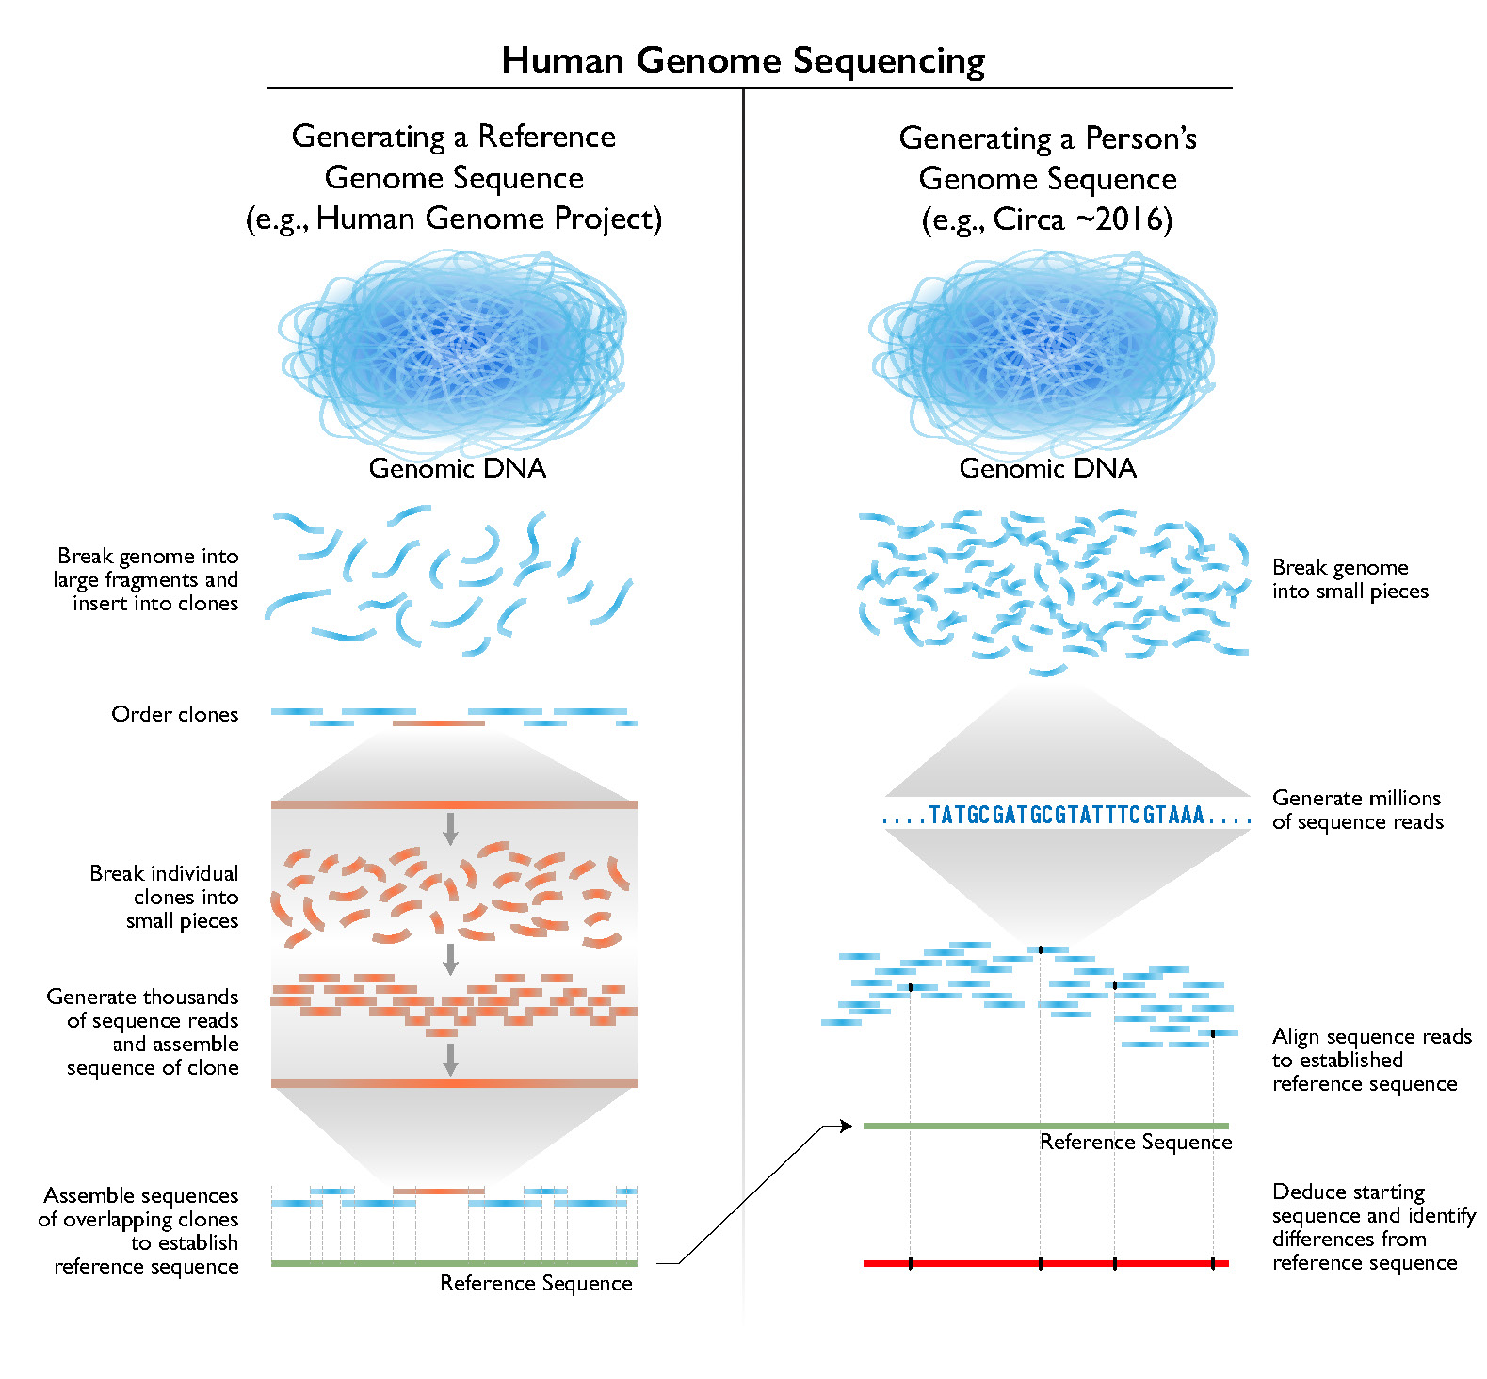
Human Genome Project: shotgun method
Once significant human genome sequencing began for the HGP, a 'draft' human genome sequence (as described above) was produced over a 15-month period (from April 1999 to June 2000). The estimated cost for generating that initial 'draft' human genome sequence is ~$300 million worldwide
https://www.genome.gov/about-genomics/fact-sheets/Sequencing-Human-Genome-cost

Slide 4
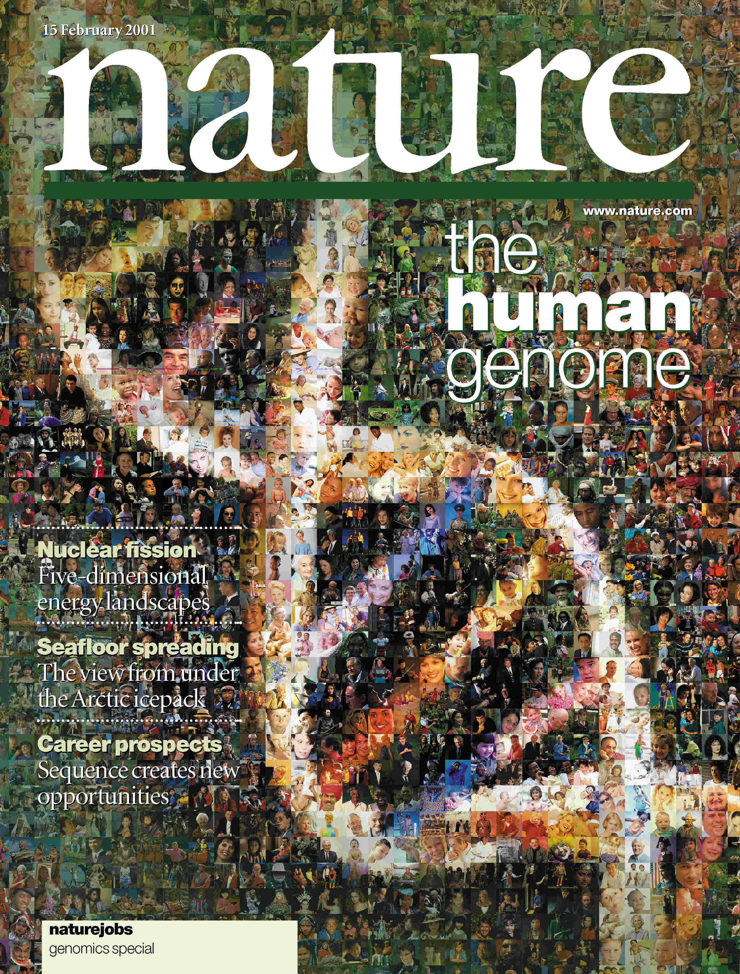
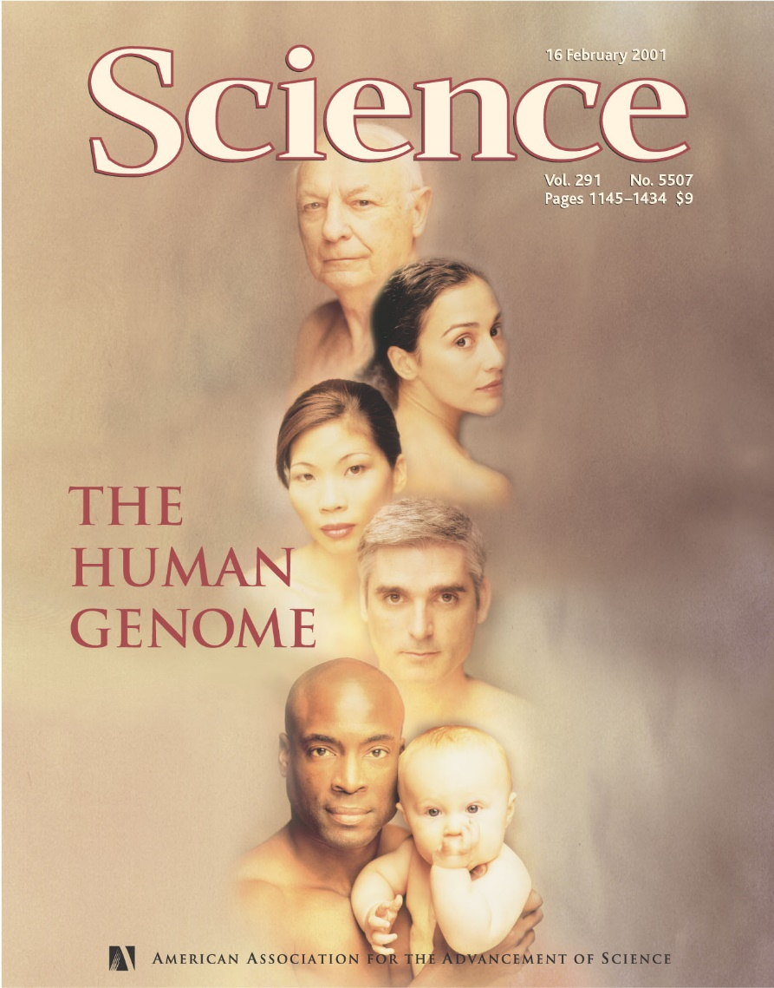
February 2001: Papers Reporting
Draft Sequence of Human Genome
HGP Paper
Venter/Celera Paper

Slide 5
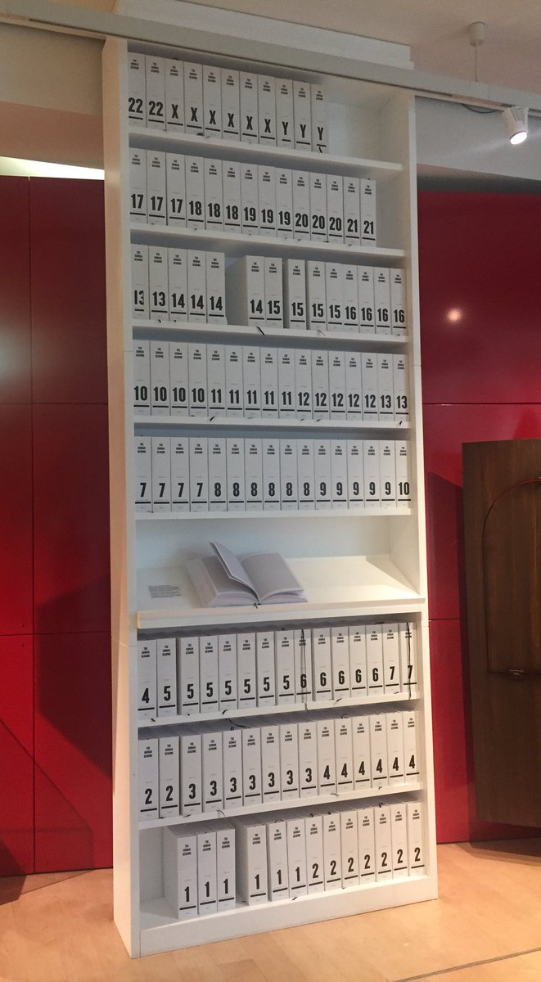
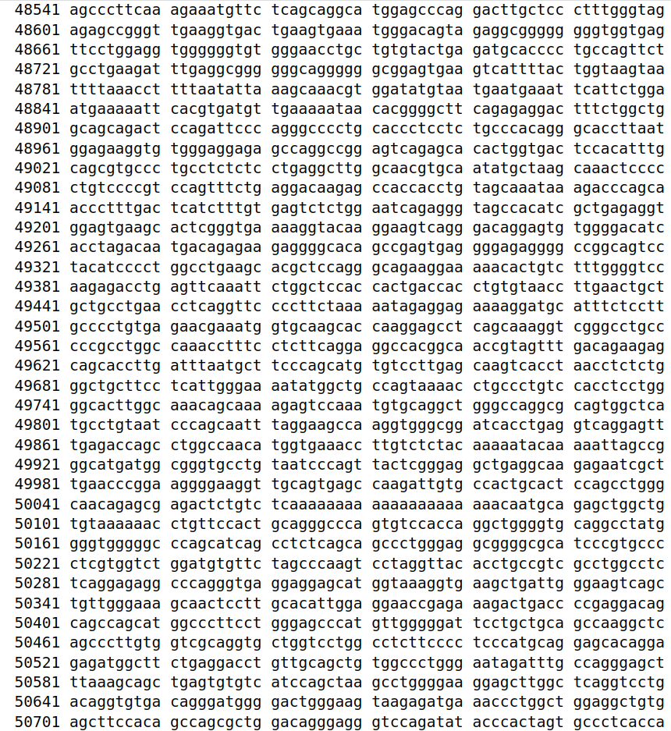
https://www.ncbi.nlm.nih.gov/nuccore/806904736

Slide 6
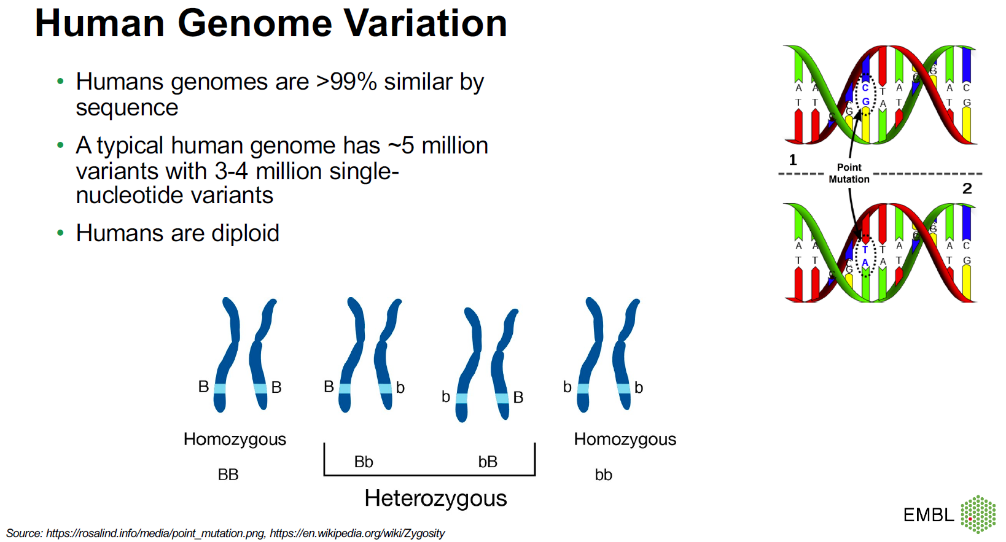
Tobias Rausch

Slide 7
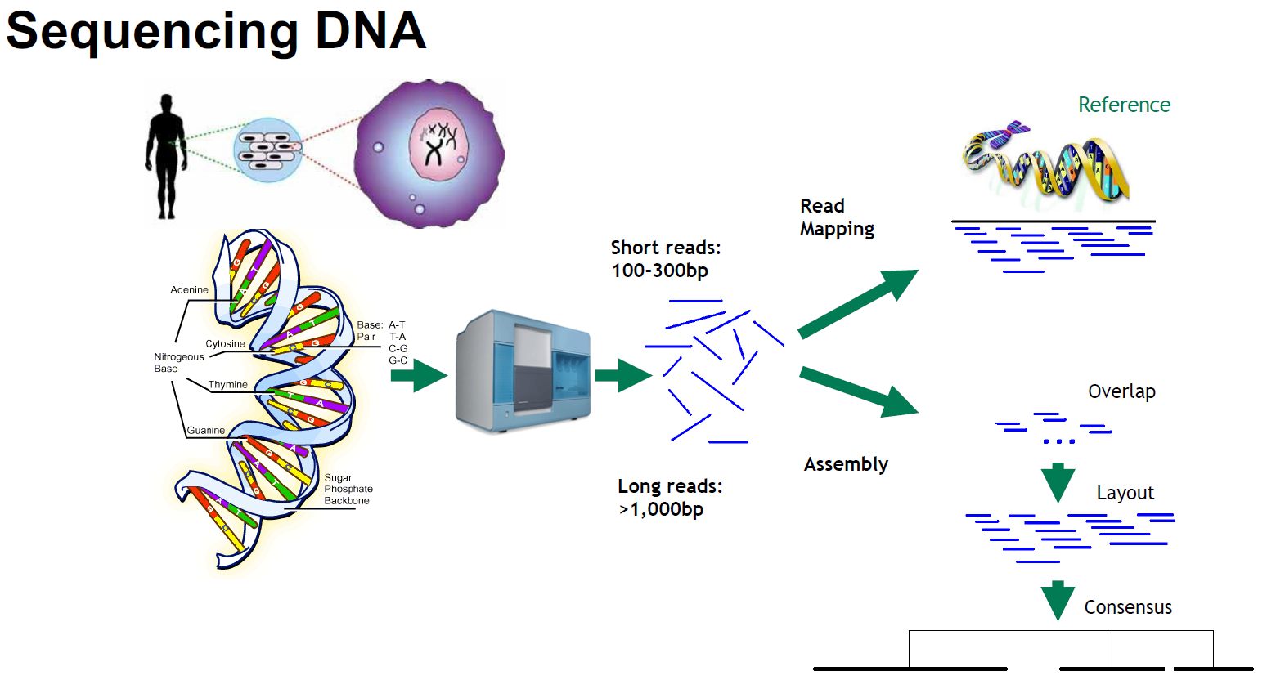
Tobias Rausch

Slide 8
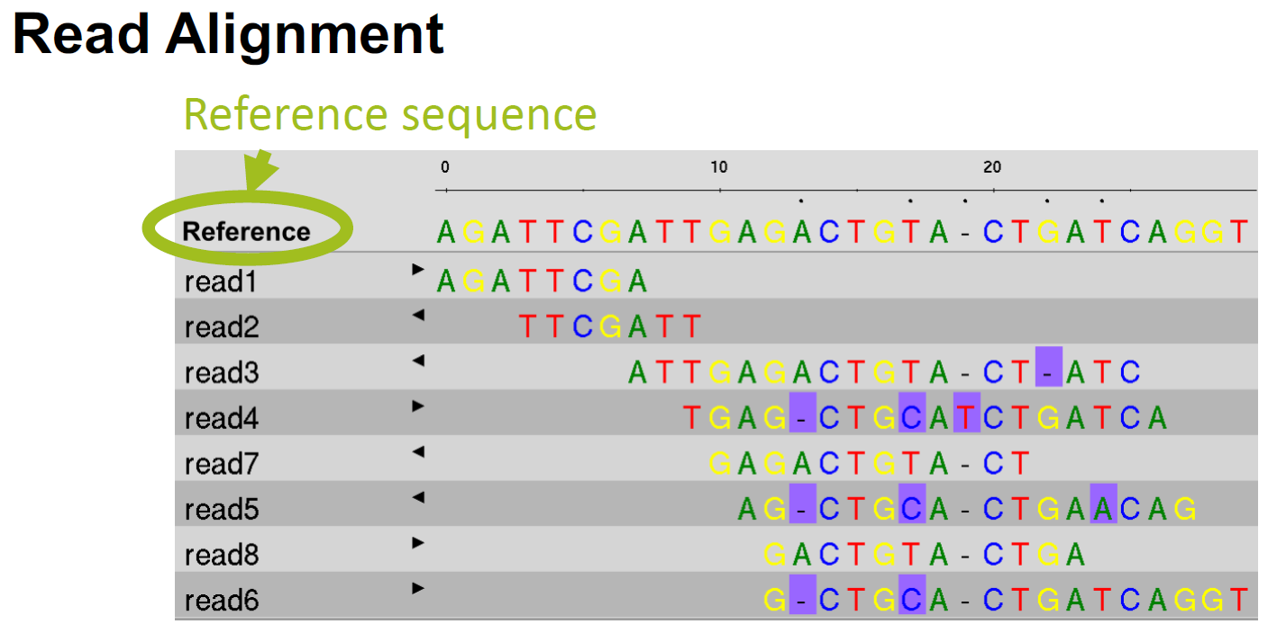
Tobias Rausch

Slide 9
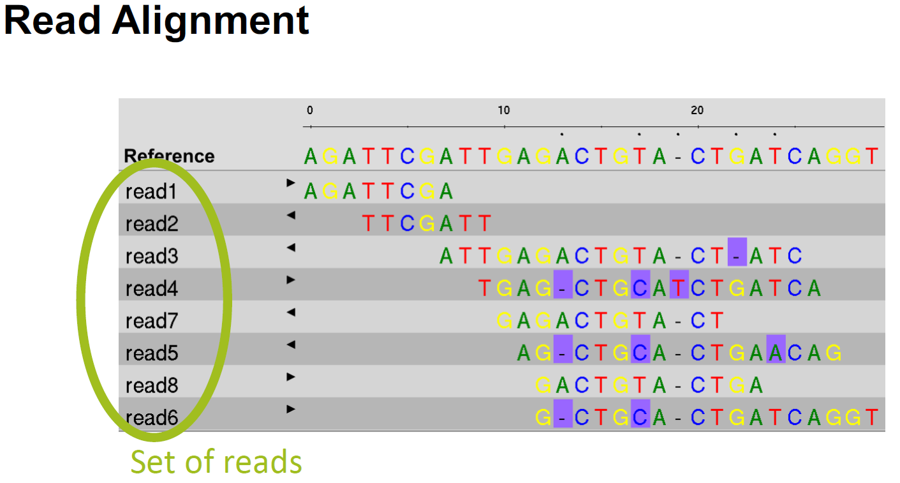
Tobias Rausch

Slide 10
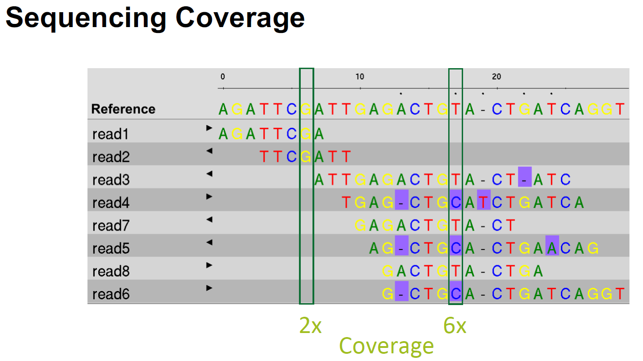
Tobias Rausch

Slide 11
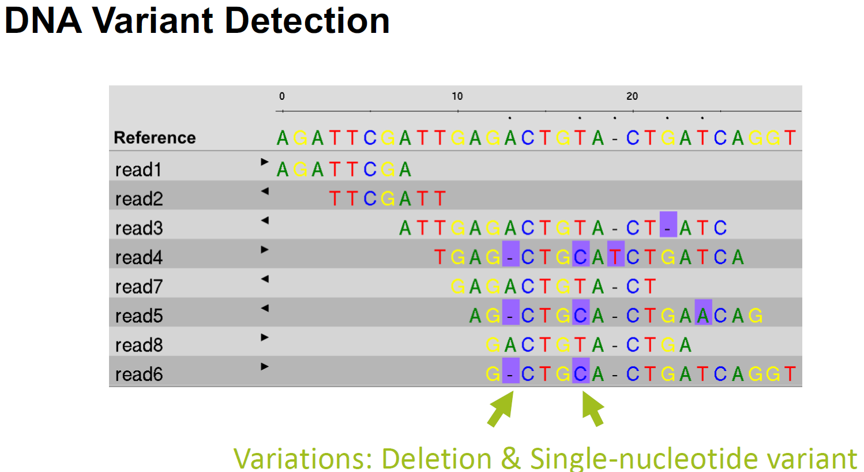
Tobias Rausch

Slide 12
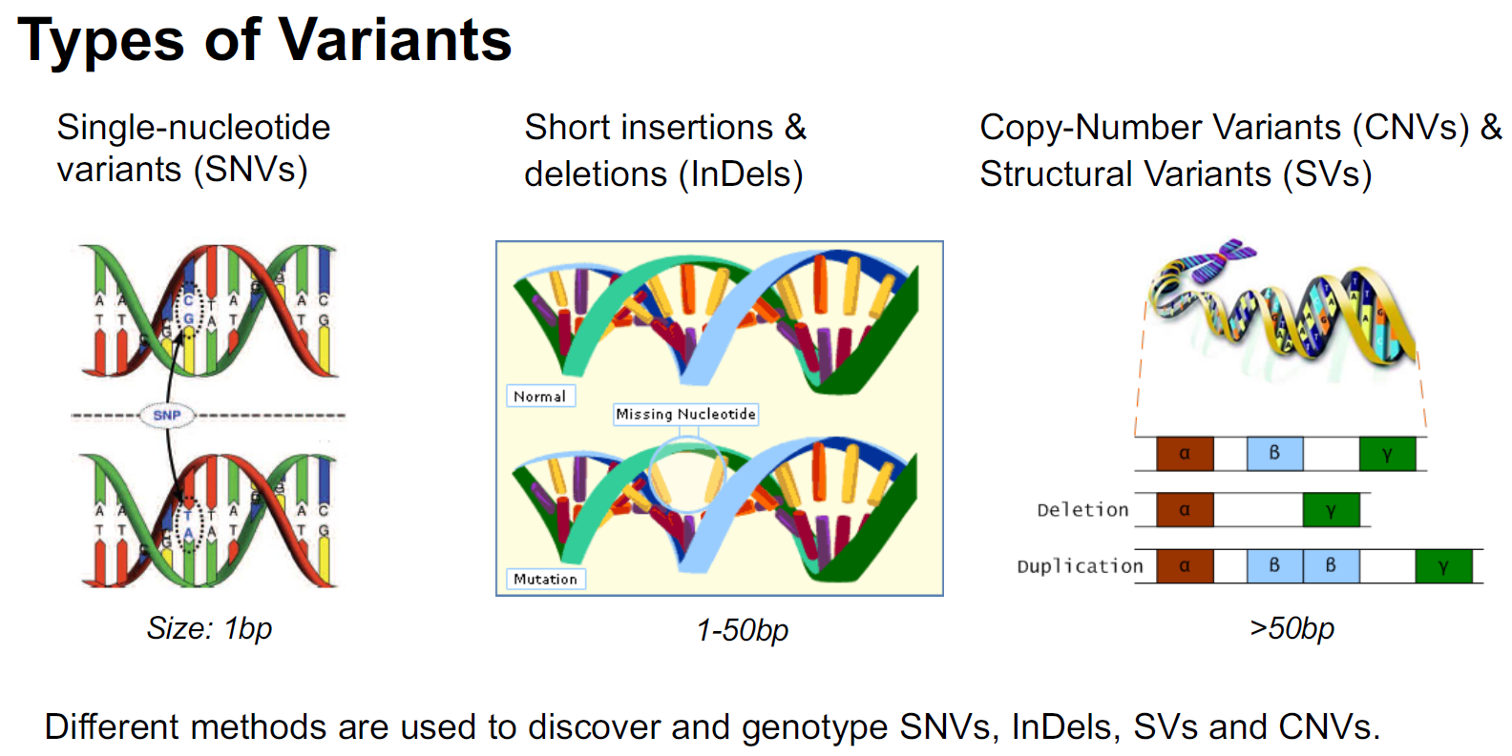
Tobias Rausch

Slide 13
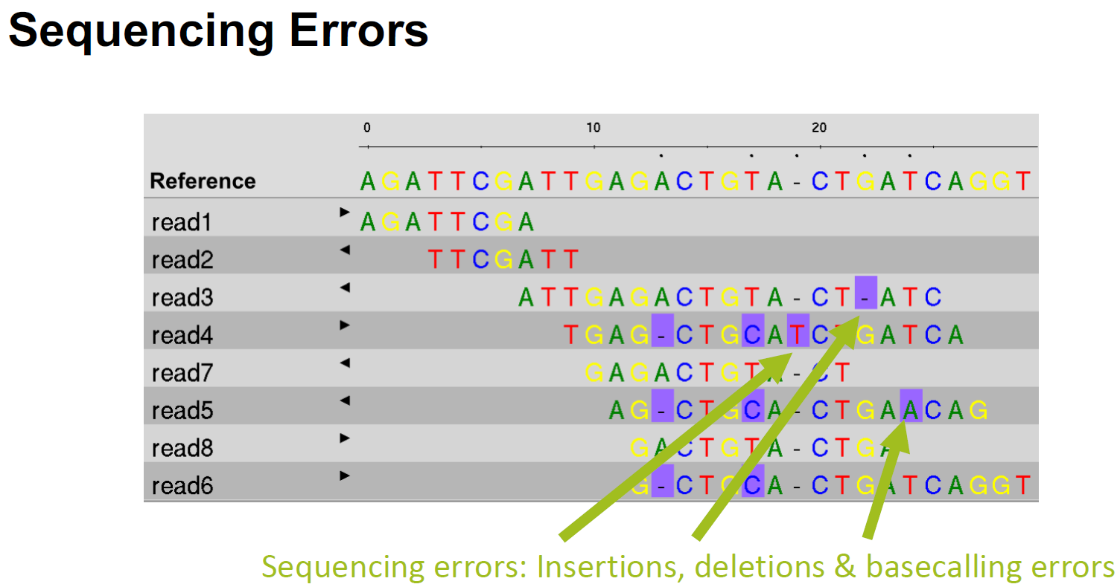
Tobias Rausch

Slide 14
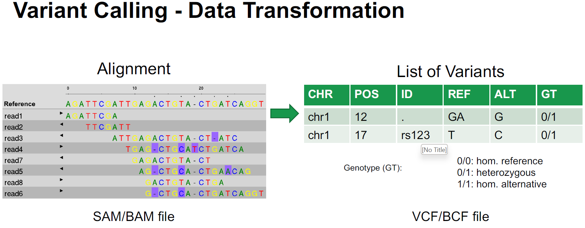
Tobias Rausch

Slide 15
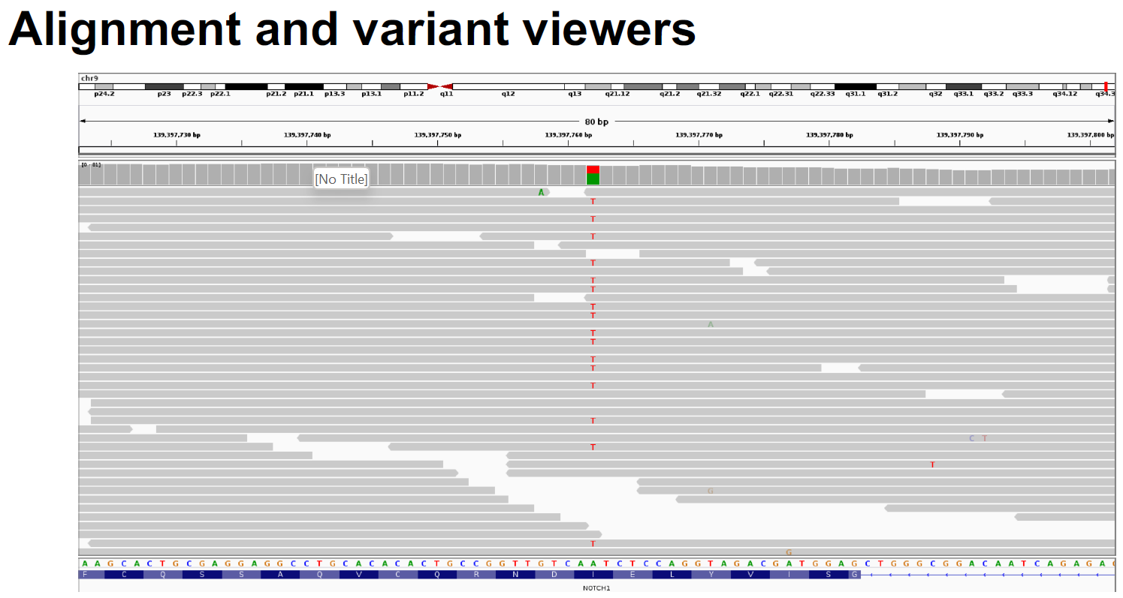
Tobias Rausch

Slide 16
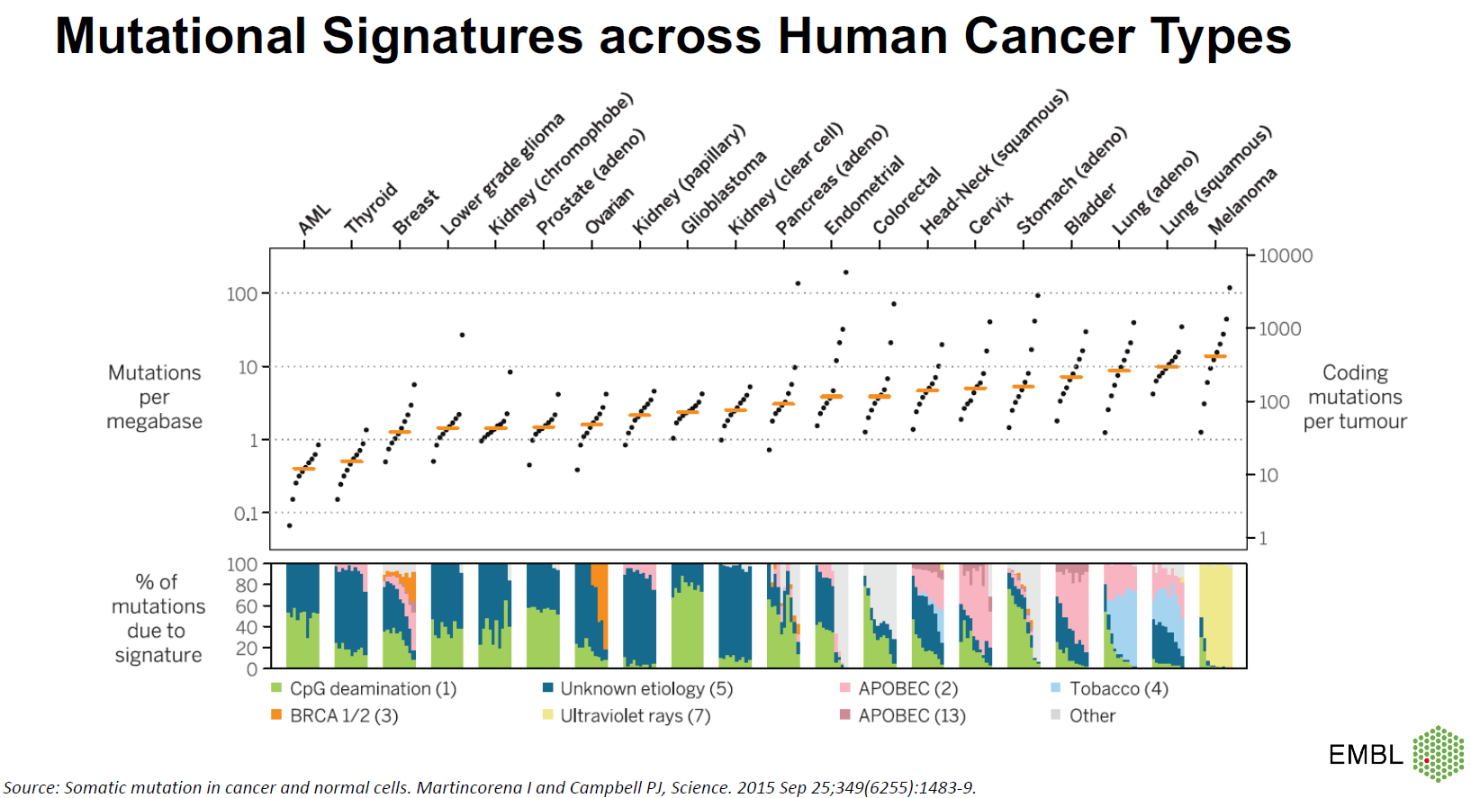
Tobias Rausch

Slide 17
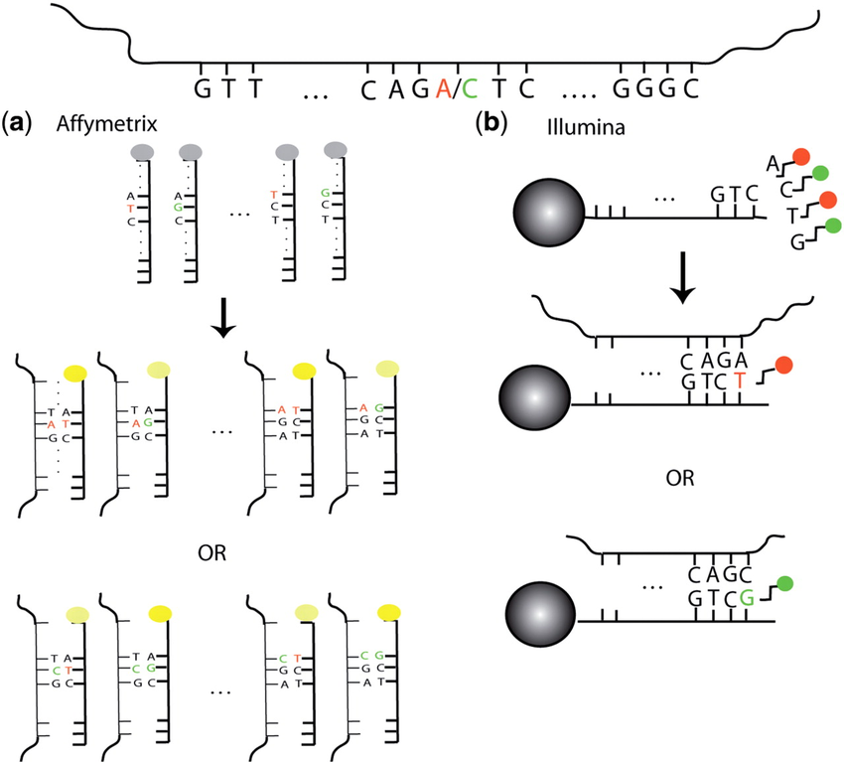
From genome sequence to SNP array
Sequenced genome and SNPs
Overview of SNP array technology. At the top is the fragment of DNA harboring an A/C SNP to be interrogated by the probes shown.
In the Affymetrix assay, there are 25-mer probes for both alleles, and the location of the SNP locus varies from probe to probe. The DNA binds to both probes regardless of the allele it carries, but it does so more efficiently when it is complementary to all 25 bases (bright yellow) rather than mismatching the SNP site (dimmer yellow). This impeded binding manifests itself in a dimmer signal.
Attached to each Illumina bead is a 50-mer sequence complementary to the sequence adjacent to the SNP site. The single-base extension (T or G) that is complementary to the allele carried by the DNA (A or C, respectively) then binds and results in the appropriately-colored signal (red or green, respectively). For both platforms, the computational algorithms convert the raw signals into inferences regarding the presence or absence of each of the two alleles.
DOI:10.1093/nar/gkp552

Slide 18
Content
Terms used in GWAS
What is GWAS?
How to do GWAS with Case-Control Association Testing?
What is QTL?
GWAS database
Why do we do GWAS?

Slide 19
Terms
Gene. The most obvious way how genetic variation can affect phenotypes is through variation in how genes function. Genes are segements of DNA that code for proteins (see yourgenome.org) and variation in the physical structure of the protein or in the time and place where the protein is made can have phenotypic consequences. Therefore, we are very interested in how genetic variation can affect the function of genes, and a lot of this is still unknown. Protein coding genes cover less than 2% of the whole human genome, but the remaining 98% affects the regulation of genes (intergenic/ enhancer/ promoter) in many ways.
Locus (pl. loci). A continuous region of the genome is called a locus (plural loci). It can be of any size (e.g. a single nucleotide site of length 1 bp or a region of 10 milion base pairs, 10 Mbp). GWAS loci are regions that include a clear statistical association with the phenotype of interest.

Slide 20
Terms
For example, my paternal chromosome can have a base A and maternal chromosome can have a base G (on the +strand of the DNA) at that position. Such a one-nucleotide variation is called a single-nucleotide variant (SNV) and the two versions are called alleles. So in the example case, I would be carrying both an allele A and an allele G at that SNV, whereas you might be carrying two copies of allele A at the same SNV.
My genotype would be AG and yours AA. An individual having different alleles on his/her two genomes is heterozygous at that locus, and an individual having two copies of the same allele is homozygous at that locus.
Since each individual has two copies of the genome, there are individuals with three possible genetic types (called genotypes) at this SNP. We denote each genotype by the number of copies of allele 1 that the genotype contains (i.e. genotype can be 0, 1 or 2).
p chr10 + ---G---
- ---C---
m chr10 + ---G---
- ---C---
p chr10 + ---T---
- ---A---
m chr10 + ---T---
- ---A---
p chr10 + ---G---
- ---C---
m chr10 + ---T---
- ---A---

Slide 21
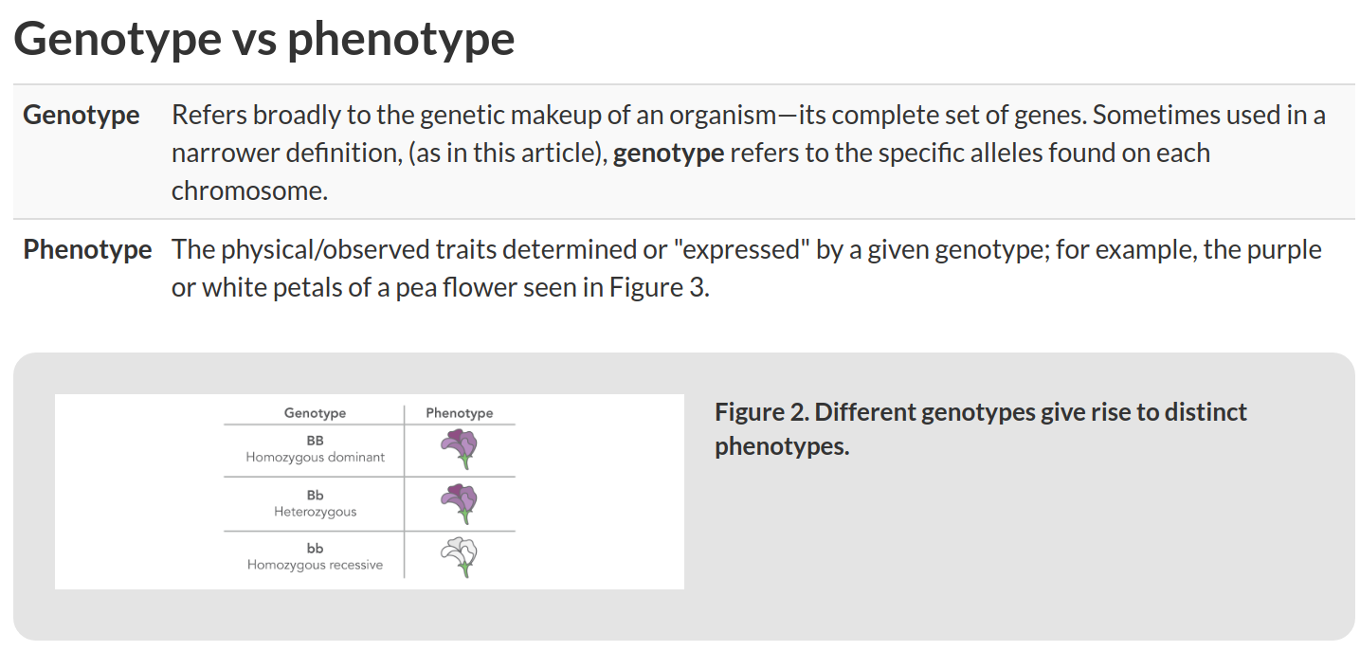
https://sg.idtdna.com/pages/education/decoded/article/genotyping-terms-to-know

Slide 22
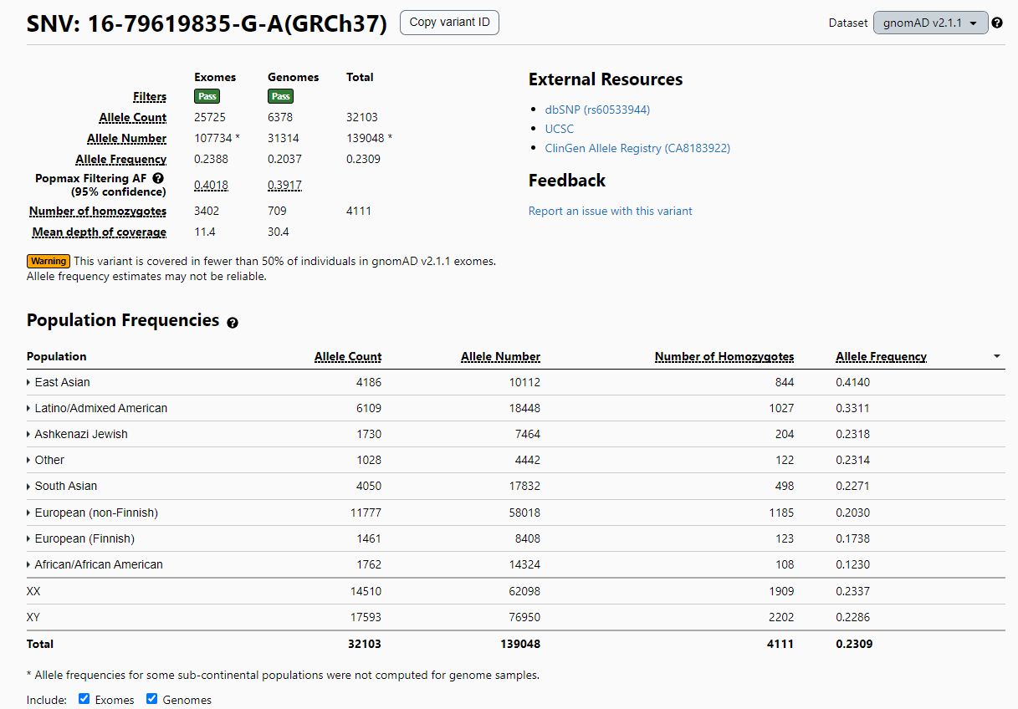
Allele Frequency
https://gnomad.broadinstitute.org/variant/16-79619835-G-A

Slide 23
Minor Allele Frequency (MAF) in Single Nucleotide Variants
Minor allele frequency (MAF) is the frequency at which the second most common allele occurs in a given population.
Single nucleotide polymorphisms (SNPs) with a minor allele frequency of 0.05 (5%) or greater were targeted by the HapMap project.^{[2]}
MAF is widely used in population genetics studies because it provides information to differentiate between common and rare variants in the population.
As an example, a 2015 study sequenced the whole genomes of 2,120 Sardinian individuals. The authors classified the variants found in the study in three classes according to their MAF. It was observed that rare variants (MAF < 0.05) appeared more frequently in coding regions than common variants (MAF > 0.05) in this population.^{[3]}

Slide 24
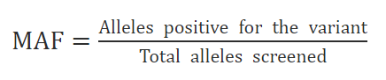
Minor Allele Frequency (MAF) in Single Nucleotide Variants
1. Introduce the reference of a SNP of interest, as an example: rs429358, in a database (dbSNP or other).
2. Find MAF/MinorAlleleCount link.
MAF/MinorAlleleCount: C=0.1506/754 where C is the minor allele for that particular locus; 0.1506 is the frequency of the C allele (MAF), i.e. 15% within the 1000 Genomes database; and 754 is the number of times this SNP has been observed in the population of the study.
https://www.sciencedirect.com/topics/biochemistry-genetics-and-molecular-biology/minor-allele-frequency

Slide 25
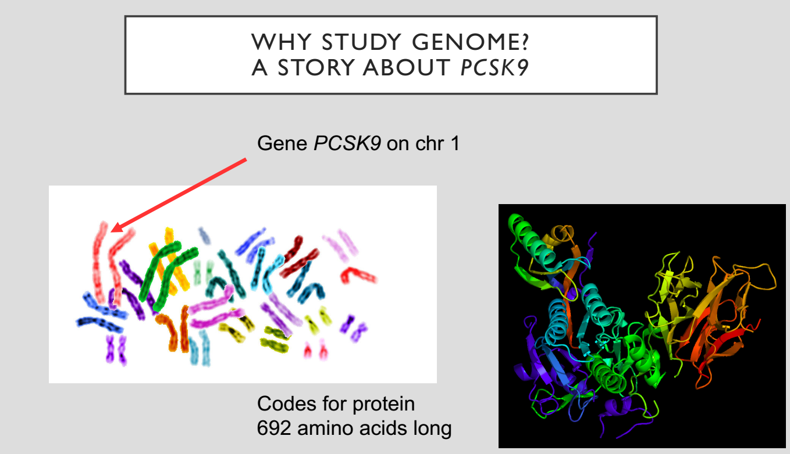

Slide 26
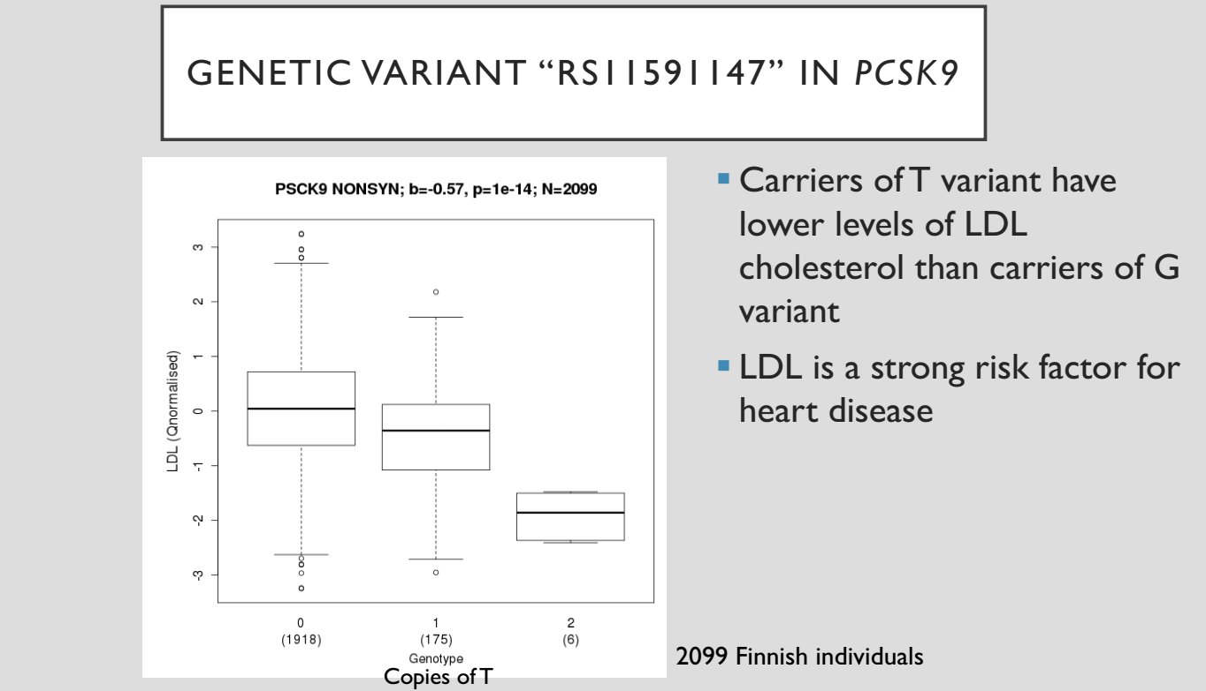

Slide 27
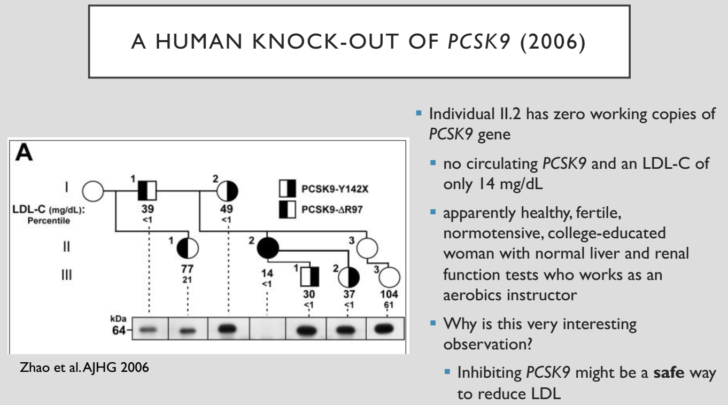

Slide 28
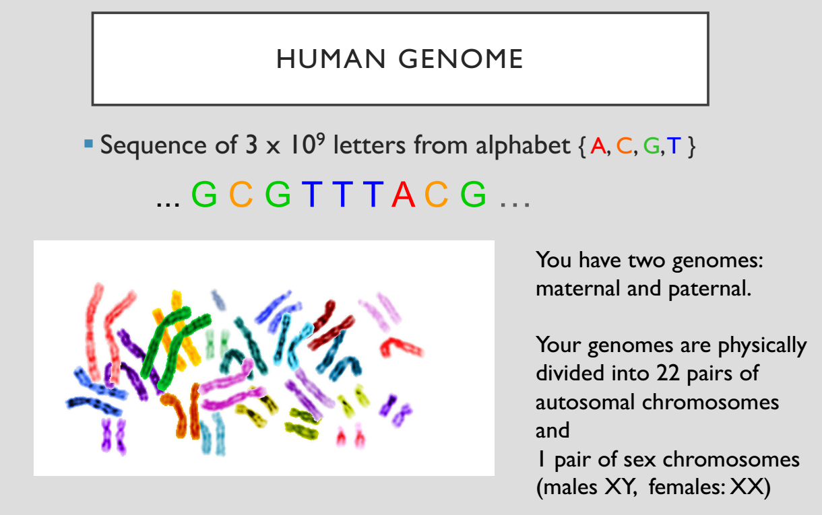

Slide 29
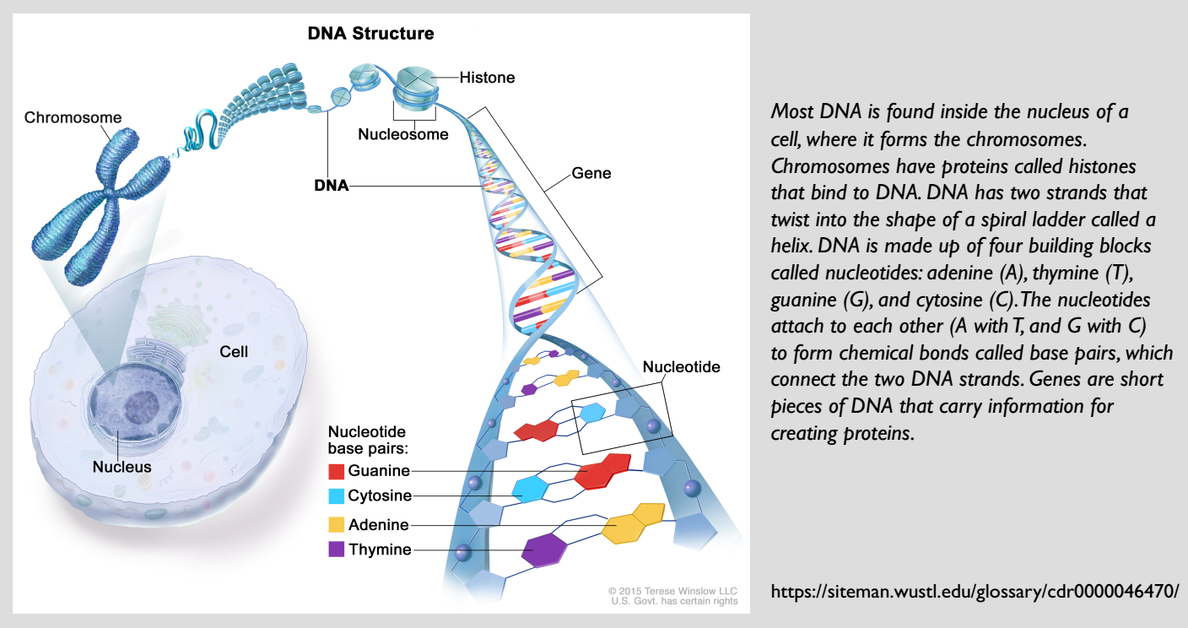

Slide 30
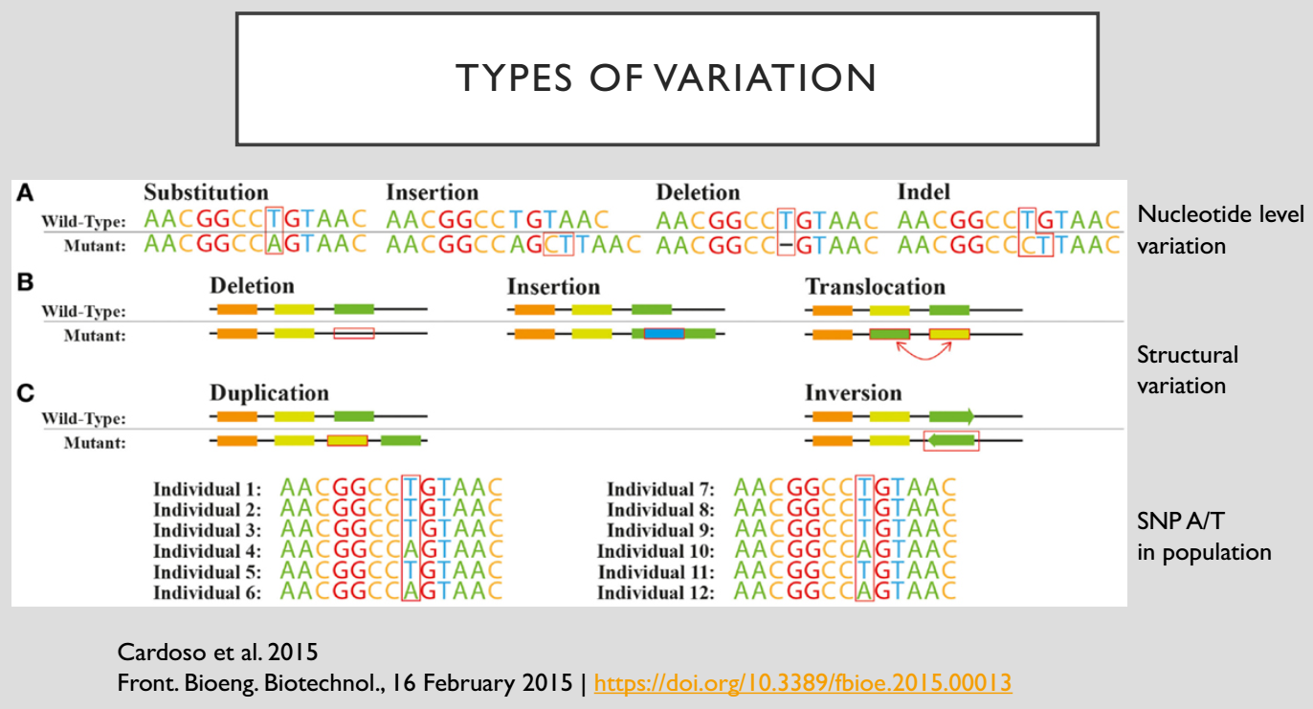

Slide 31
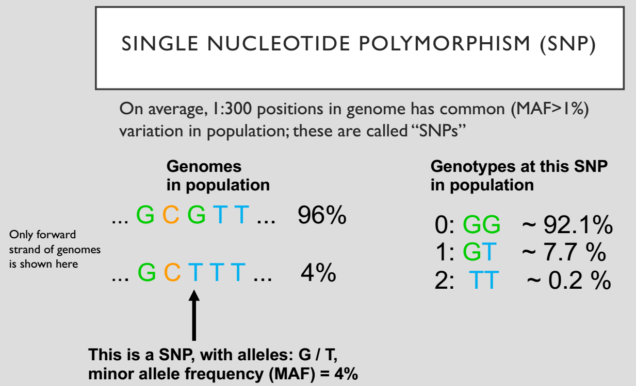
p chr10 + ---G---
- ---C---
m chr10 + ---G---
- ---C---
p chr10 + ---T---
- ---A---
m chr10 + ---T---
- ---A---
p chr10 + ---G---
- ---C---
m chr10 + ---T---
- ---A---

Slide 32
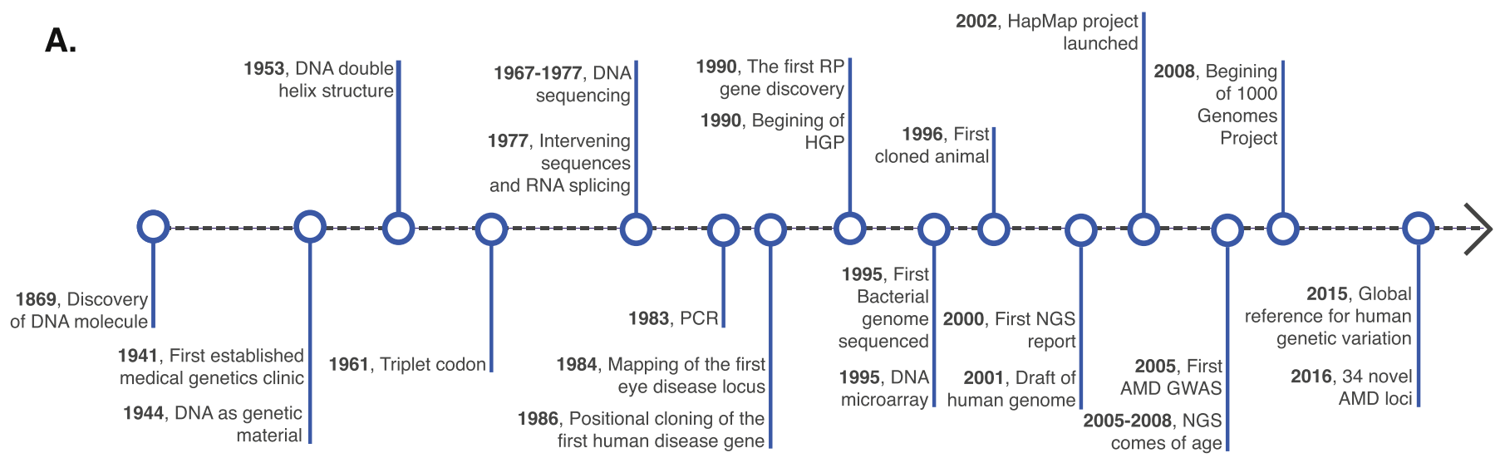
Timeline of human genetics and genomic technologies
Age-related macular degeneration (AMD)
Human Genome Project (HGP)
http://dx.doi.org/10.1016/j.preteyeres.2016.06.001

Slide 33
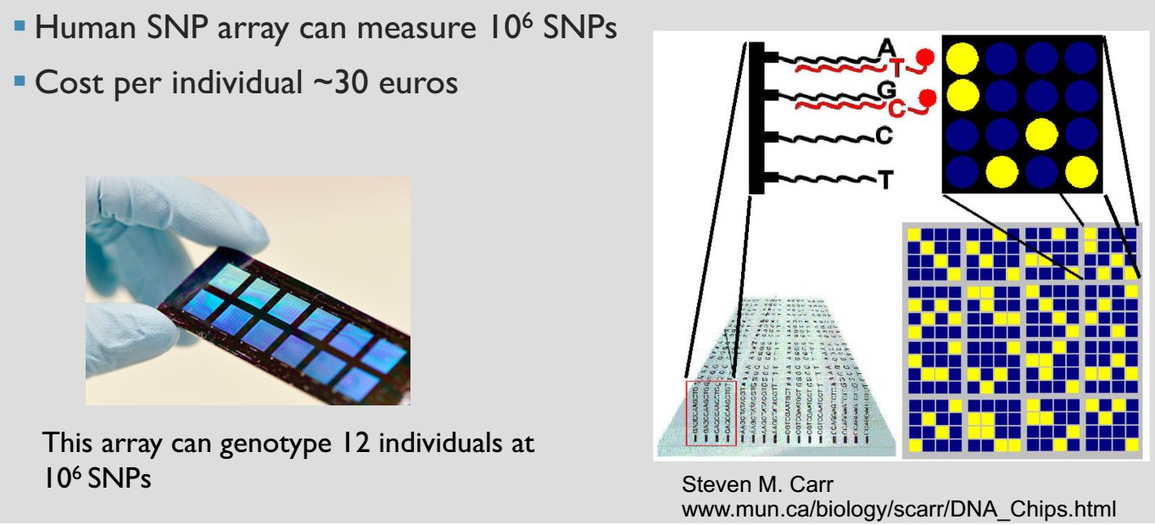
Profiling SNPs

Slide 34
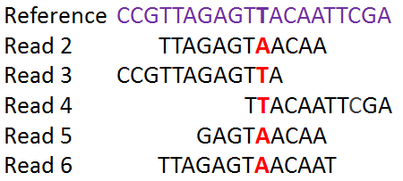
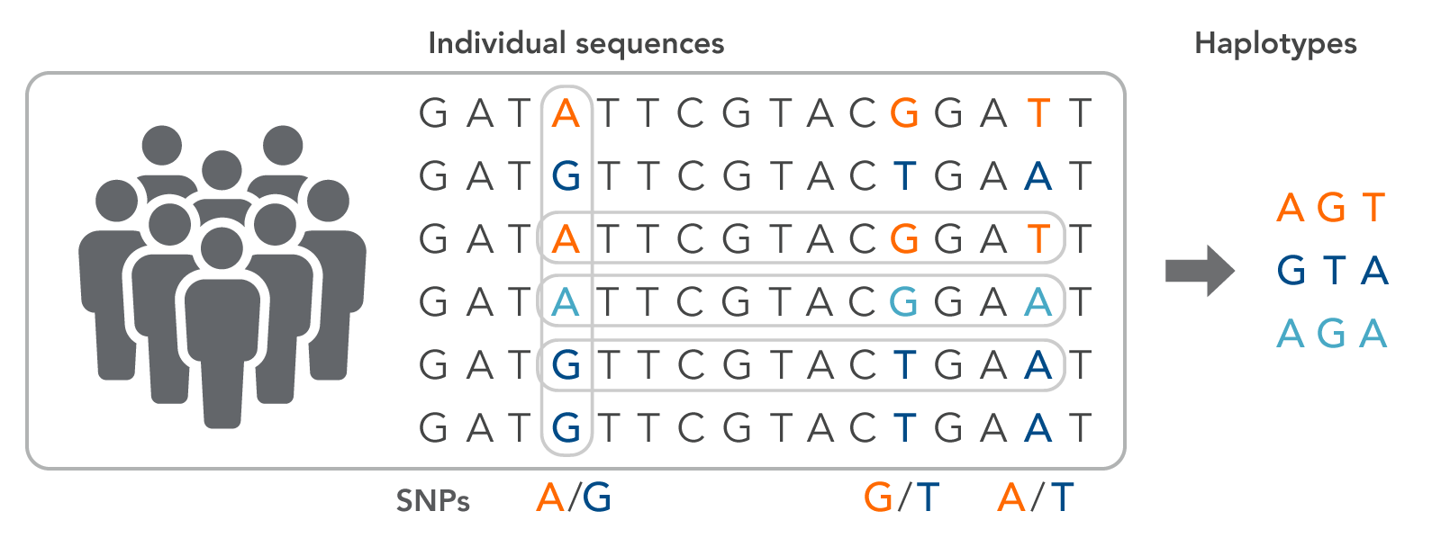
Whole genome sequencing (WGS), Whole Exome Sequencing (WES) and Target Sequencing with NGS
One individual
Multi individual
https://online.stat.psu.edu/stat555/node/106/

Slide 35
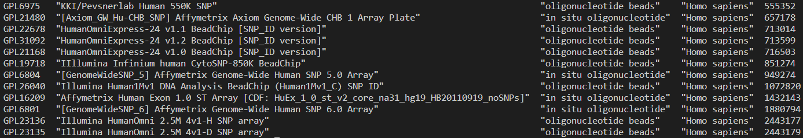
SNP Arrays
GEO Browser - GEO - NCBI (nih.gov)

Slide 36
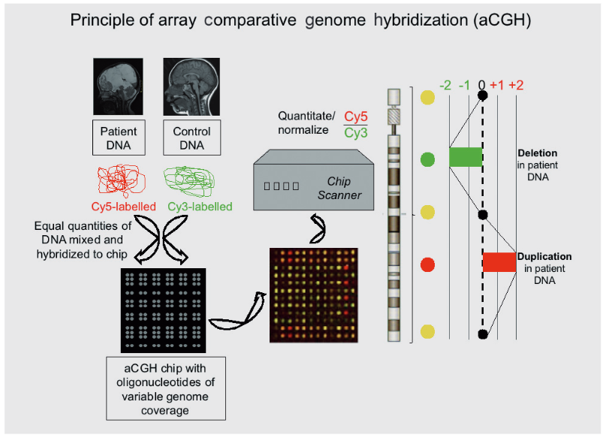
Comparative genome hybridization (CGH)
CGH is a molecular-cytogenetic method for the analysis of copy number changes (gains or losses) in the DNA content of a given individual’s DNA.
A glossary of relevant genetic terms (tandfonline.com)

Slide 37
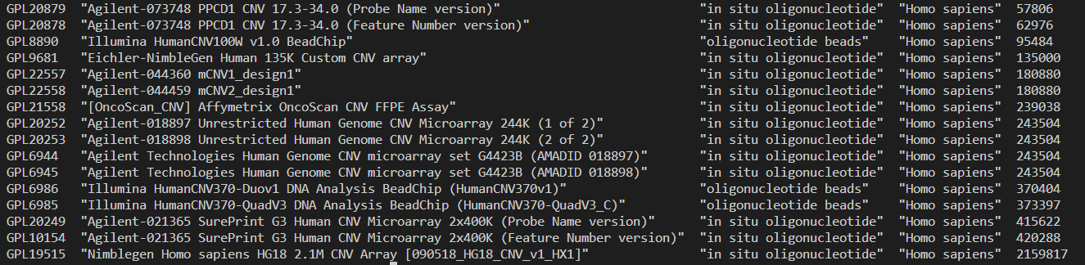
CNV Arrays
GEO Browser - GEO - NCBI (nih.gov)

Slide 38
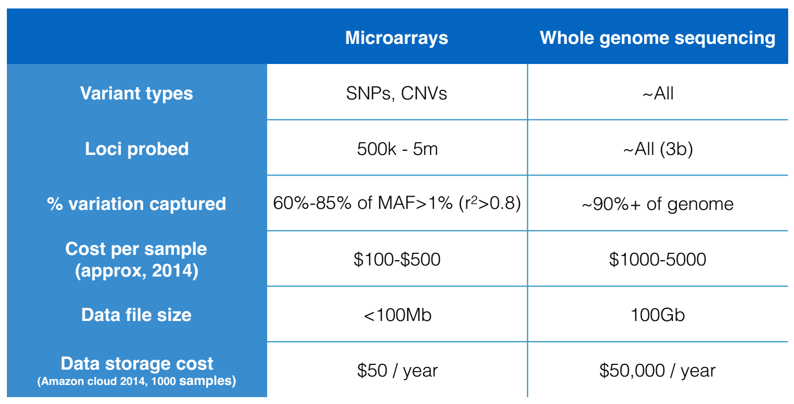
Experiment design

Slide 39
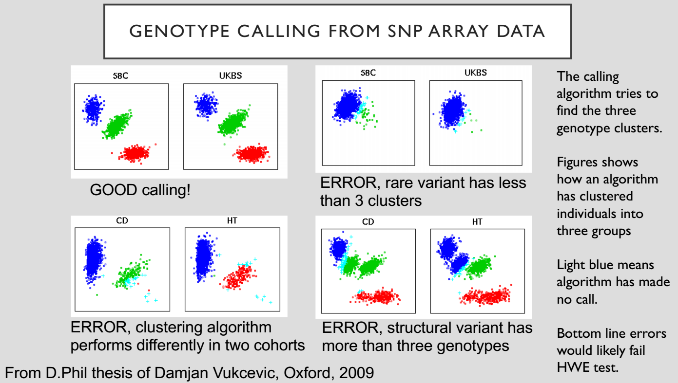

Slide 40
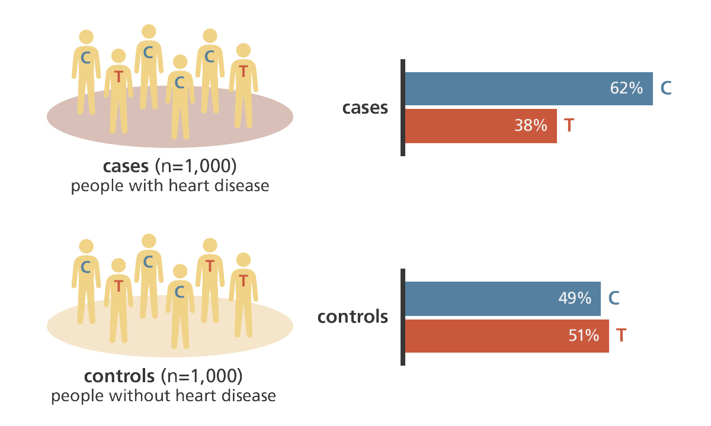
Example of heart disease at Chr1 Pos 12345
https://www.yourgenome.org/stories/genome-wide-association-studies

Slide 41
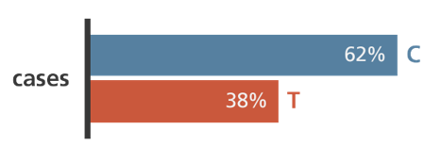
Example of heart disease at Chr1 Pos 543256
Control
https://www.yourgenome.org/stories/genome-wide-association-studies

Slide 42
Review statistics
Chr1-10 | C | T | Total
Case | 620 | 380 | 1000
Control | 490 | 510 | 1000
Total | 1110 | 890 | 2000
Chr1-20 | A | G | Total
Case | 620 | 380 | 1000
Control | 610 | 390 | 1000
Total | 1230 | 770 | 2000
>dat <- data.frame(
"C" = c(620,490),
"T" = c(380,510),
row.names = c("Case", "Control"),
stringsAsFactors = FALSE
)
>colnames(dat) <- c("C", "T")
>chisq.test(dat)
Pearson's Chi-squared test with Yates' continuity correction
data: dat
X-squared = 33.69, df = 1, p-value = 6.464e-09
> fisher.test(dat)
Fisher's Exact Test for Count Data
data: dat
p-value = 6.15e-09
alternative hypothesis: true odds ratio is not equal to 1
95 percent confidence interval:
1.415601 2.037173
sample estimates:
odds ratio
1.697752
> dat <- data.frame(
"A" = c(620,610),
"G" = c(380,390),
row.names = c("Case", "Control"),
stringsAsFactors = FALSE
)
colnames(dat) <- c("C", "T")
> chisq.test(dat)
Pearson's Chi-squared test with Yates' continuity correction
data: dat
X-squared = 0.17105, df = 1, p-value = 0.6792
> fisher.test(dat)
Fisher's Exact Test for Count Data
data: dat
p-value = 0.6792
alternative hypothesis: true odds ratio is not equal to 1
95 percent confidence interval:
0.8676031 1.2542032
sample estimates:
odds ratio
1.043142

Slide 43
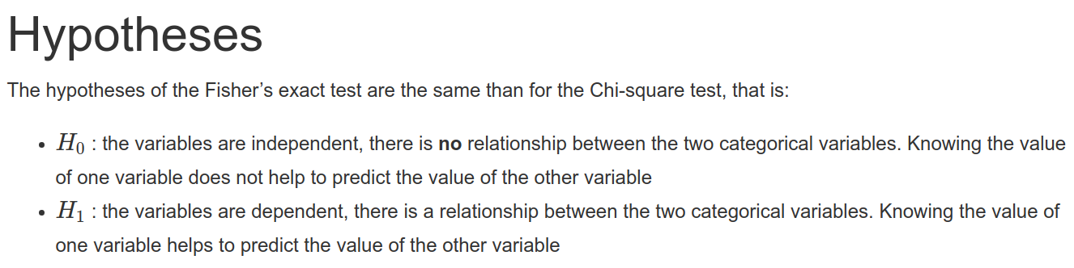
Review statistics
Chr1-10 | C | T | Total
Case | 620 | 380 | 1000
Control | 490 | 510 | 1000
Total | 1110 | 890 | 2000
Chr1-20 | A | G | Total
Case | 620 | 380 | 1000
Control | 610 | 390 | 1000
Total | 1230 | 770 | 2000
Since pvalue < 0.05
Accept H1: There is a relation between disease case/control with allelic C/T at Chr1-10
Since pvalue > 0.05
Reject H1: Disease case/control and allelic C/T are independent at Chr1-20
https://statsandr.com/blog/fisher-s-exact-test-in-r-independence-test-for-a-small-sample/

Slide 44
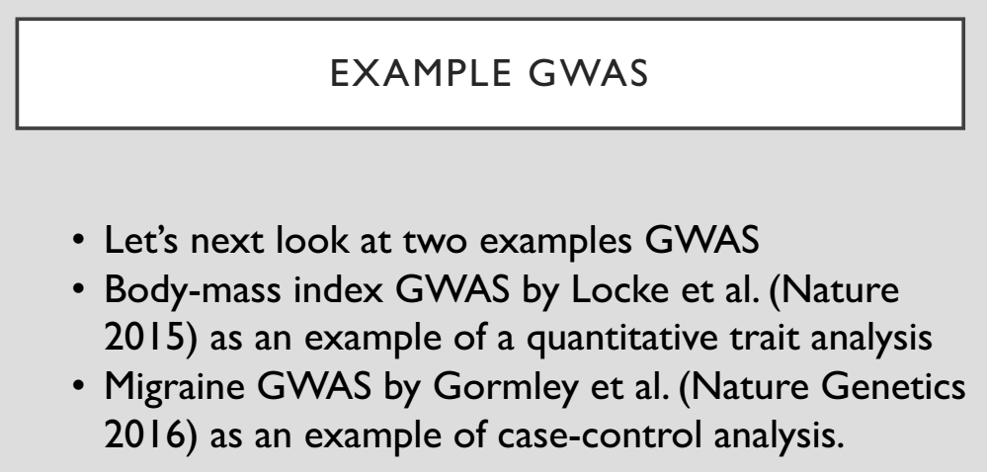

Slide 45
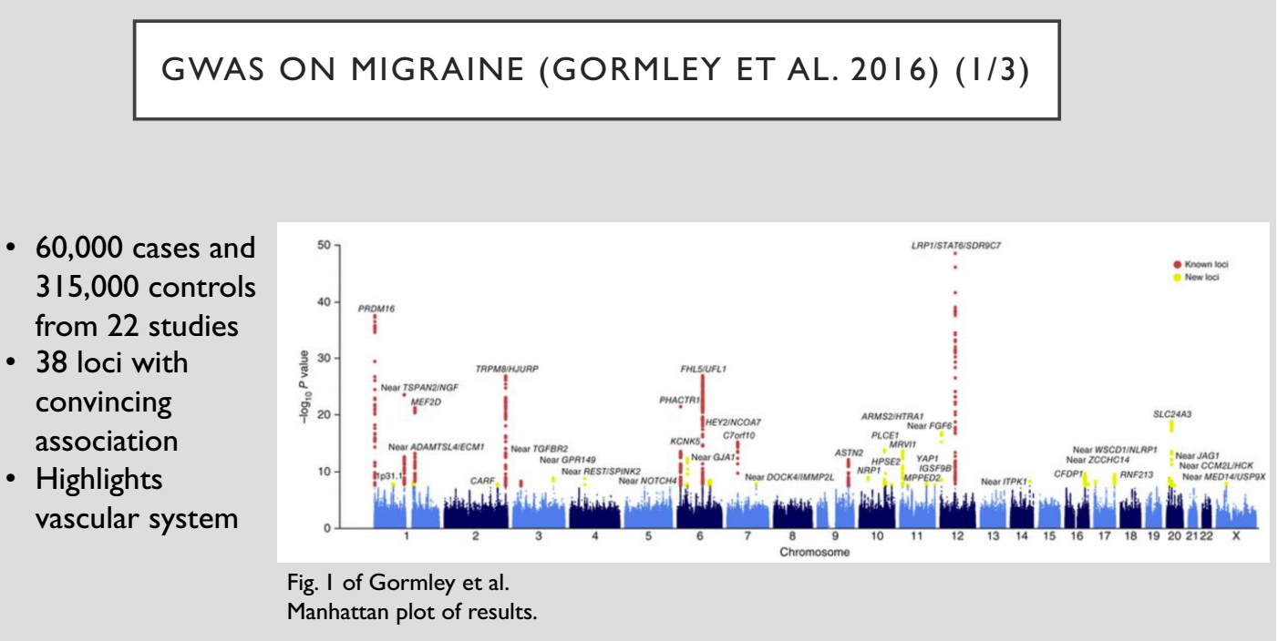

Slide 46
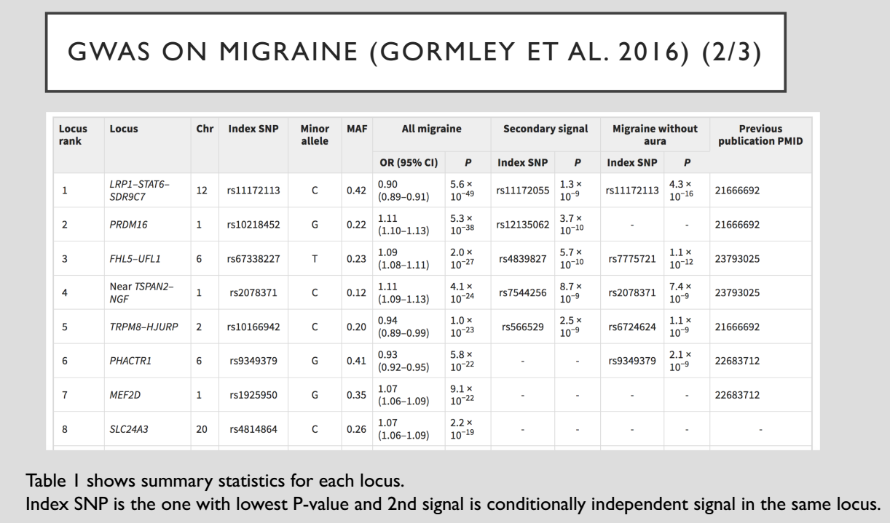

Slide 47
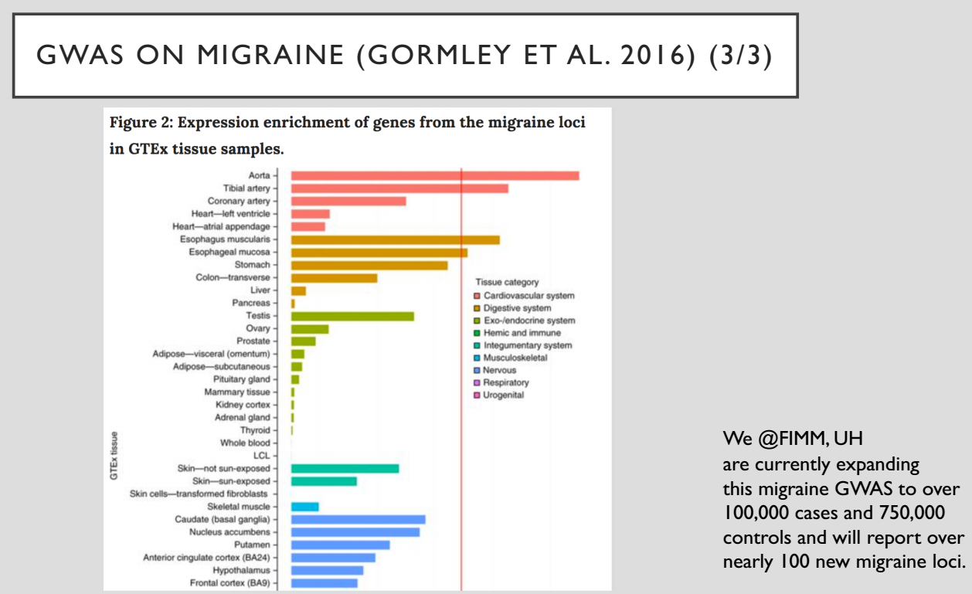

Slide 48
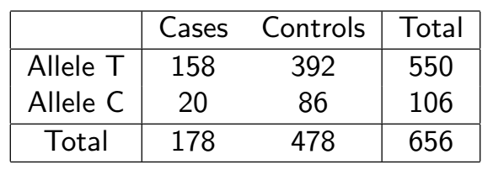
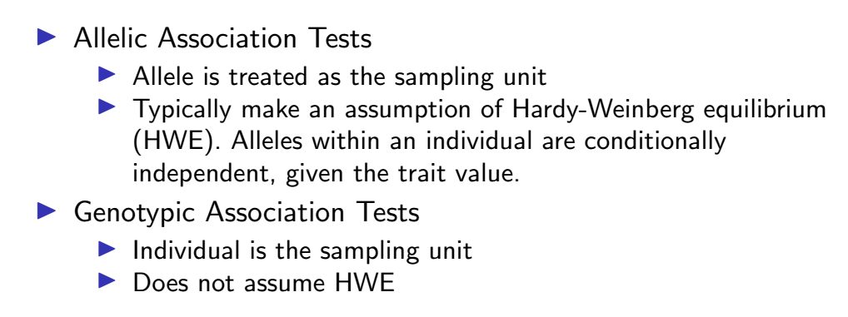
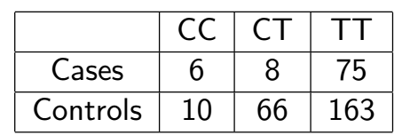
Case-Control Association Testing

Slide 49
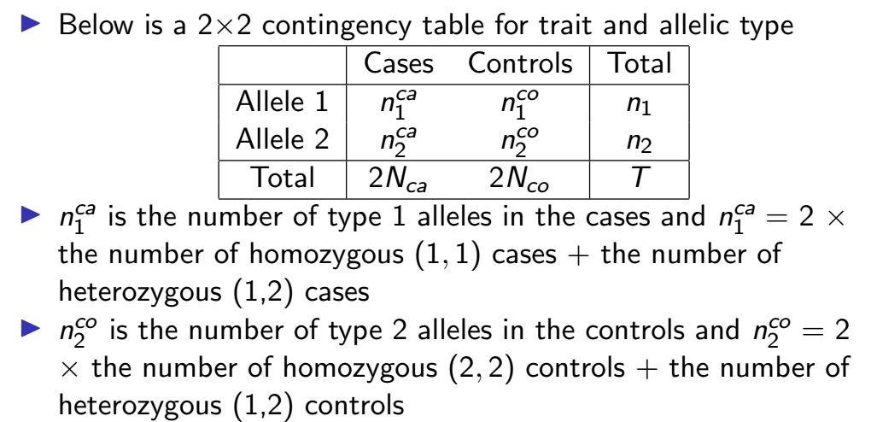
Chi-square test for Allelic Association

Slide 50
Chi-square test for Allelic Association
Chr1-10 | C | T | Total
Case | 620 | 380 | 1000
Control | 490 | 510 | 1000
Total | 1110 | 890 | 2000
Chr1-20 | A | G | Total
Case | 620 | 380 | 1000
Control | 610 | 390 | 1000
Total | 1230 | 770 | 2000
>dat <- data.frame(
"C" = c(620,490),
"T" = c(380,510),
row.names = c("Case", "Control"),
stringsAsFactors = FALSE
)
>colnames(dat) <- c("C", "T")
>chisq.test(dat)
Pearson's Chi-squared test with Yates' continuity correction
data: dat
X-squared = 33.69, df = 1, p-value = 6.464e-09
> fisher.test(dat)
Fisher's Exact Test for Count Data
data: dat
p-value = 6.15e-09
alternative hypothesis: true odds ratio is not equal to 1
95 percent confidence interval:
1.415601 2.037173
sample estimates:
odds ratio
1.697752
> dat <- data.frame(
"A" = c(620,610),
"G" = c(380,390),
row.names = c("Case", "Control"),
stringsAsFactors = FALSE
)
colnames(dat) <- c("C", "T")
> chisq.test(dat)
Pearson's Chi-squared test with Yates' continuity correction
data: dat
X-squared = 0.17105, df = 1, p-value = 0.6792
> fisher.test(dat)
Fisher's Exact Test for Count Data
data: dat
p-value = 0.6792
alternative hypothesis: true odds ratio is not equal to 1
95 percent confidence interval:
0.8676031 1.2542032
sample estimates:
odds ratio
1.043142

Slide 51
Chi-square test for Allelic Association
Chr1-10 | C | T | Total
Case | 620 | 380 | 1000
Control | 490 | 510 | 1000
Total | 1110 | 890 | 2000
Chr1-20 | A | G | Total
Case | 620 | 380 | 1000
Control | 610 | 390 | 1000
Total | 1230 | 770 | 2000
Since p-value < 0.05
Accept H1: There is a relation between disease case/control with allelic C/T at Chr1-10
Since p-value > 0.05
Reject H1: Disease case/control and allelic C/T are independent at Chr1-20
https://statsandr.com/blog/fisher-s-exact-test-in-r-independence-test-for-a-small-sample/

Slide 52
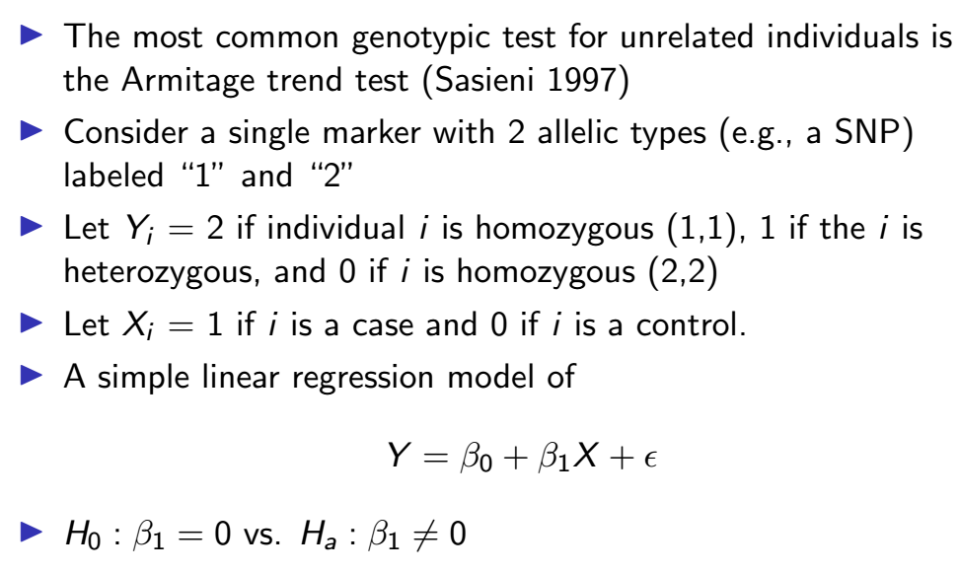
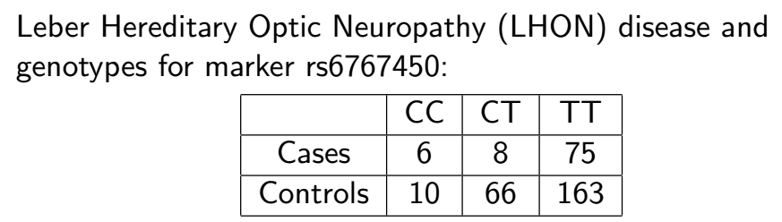
The Armitage Trend Test for Genotypic Association

Slide 53

Quantitative trait loci (QTL)
An overview of association testing methods when the trait of interest is binary or case/control (e.g. 1/0, affected/unaffected, dead/alive).
Phenotypes of interest are often quantitative.
The field of quantitative genetics is the study of the inheritance of continuously measured traits and their mechanisms.
Quantitative trait loci (QTL) mapping involves identifying genetic loci that influence the phenotypic variation of a quantitative trait.

Slide 54

Overview of steps for conducting GWAS
a | Data can be collected from study cohorts or available genetic and phenotypic information can be used from biobanks or repositories. Confounders need to be carefully considered and recruitment strategies must not introduce biases such as collider bias.
b | Genotypic data can be collected using microarrays to capture common variants, or next-generation sequencing methods for whole-genome sequencing (WGS) or whole-exome sequencing (WES).
c | Quality control includes steps at the wet-laboratory stage, such as genotype calling and DNA switches, and dry-laboratory stages on called genotypes, such as deletion of bad single-nucleotide polymorphisms (SNPs) and individuals, detection of population strata in the sample and calculation of principle components. Figure depicts clustering of individuals according to genetic substrata.
d | Genotypic data can be phased, and untyped genotypes imputed using information from matched reference populations from repositories such as 1000 Genomes Project or TopMed. In this example, genotypes of SNP1 and SNP3 are imputed based on the directly assayed genotypes of other SNPs.
e | Genetic association tests are run for each genetic variant, using an appropriate model (for example, additive, non-additive, linear or logistic regression). Confounders are corrected for, including population strata, and multiple testing needs to be controlled. Output is inspected for unusual patterns and summary statistics are generated.
f | Results from multiple smaller cohorts are combined using standardized statistical pipelines.
g | Results can be replicated using internal replication or external replication in an independent cohort. For external replication, the independent cohort must be ancestrally matched and not share individuals or family members with the discovery cohort.
h | In silico analysis of genome-wide association studies (GWAS), using information from external resources. This can include in silico fine-mapping, SNP to gene mapping, gene to function mapping, pathway analysis, genetic correlation analysis, Mendelian randomization and polygenic risk prediction. After GWAS, functional hypotheses can be tested using experimental techniques such as CRISPR or massively parallel reporter assays, or results can be validated in a human trait/disease model (not shown).
10.1038/s43586-021-00056-9

Slide 55

Manhattan plot and quantile–quantile plot to visualize GWAS results
a | Manhattan plot showing significance of each variant’s association with a phenotype (body mass index in this case77). Each dot represents a single-nucleotide polymorphism (SNP), with SNPs ordered on the x axis according to their genomic position. y axis represents strength of their association measured as –log10 transformed P values. Red line marks genome-wide significance threshold of P < 5 × 10–8. b | Quantile–quantile plot showing distribution of expected P values under a null model of no significance versus observed P values. Expected –log10 transformed P values (x axis) for each association are plotted against observed values (y axis) to visualize the enrichment of association signal. Deviation from the expectation under the null hypothesis (red line) indicates the presence of either true causal effects or insufficiently corrected population stratification. In the case of true causal effects, one would expect to observe this deviation mostly at the right side of the plot, whereas population stratification causes the deviation to start closer to the origin. In this case, BMI is extremely polygenic and the genome-wide association study (GWAS) was highly powered, which may also cause the deviation to start close to the origin, making it difficult to visually spot stratification. LDSC may be used to assess whether this inflation is due to bias or polygenicity.

Slide 56

Illustration of functional follow-up of GWAS
a | Genome-wide association studies (GWAS) are conducted to identify associated variants, often visualized as a Manhattan plot to show their genomic positions and strength of association. b | To prioritize likely causal variants, statistical fine-mapping is applied to identify a set of variants that are likely to include the causal variant (blue box) as well as the most likely causal variant (rs12345; blue dot). Massively parallel reporter assays can be used to measure whether alleles differ in their ability to drive gene expression or other molecular activity for each variant (not shown).

Slide 57
Illustration of functional follow-up of GWAS
c | Functional annotations of the genome can be integrated with GWAS data to identify epigenetic mechanisms that may be perturbed by the causal variant, including enhancers, promoters or other functional elements. Additional approaches include mapping molecular quantitative trait loci (molQTL) or in vitro assays (not shown). d | Target gene for a GWAS locus can be prioritized by mapping expression quantitative trait loci (eQTLs) (left) and their co-localization (right) to identify loci where the causal variant from GWAS is also a causal variant affecting gene expression. For GWAS variants in enhancers, high-throughput chromosome conformation capture (Hi-C) data and maps of enhancer target genes can be used together with simple prioritization by distance to identify genes affected by the causal variant (below). e | To identify pathways whose perturbation may mediate the trait in question (red box), one can analyse the enrichment of multiple GWAS-implicated genes in predefined pathways. Additional approaches include trans-eQTL mapping and CRISPR perturbation of GWAS loci/genes followed by cellular phenotyping (not shown). For these analyses, the context of a relevant tissue, cell type and cell state needs to be carefully considered and analysed. ATAC-seq, assay for transposase-accessible chromatin using sequencing; H3K27Ac, histone H3 acetylated at K27; SNP, single-nucleotide polymorphism.

Slide 58

Polygenic Diseases

Slide 59


Overview of the steps necessary for calculating PRSs
Step 1: genome-wide association studies (GWAS) summary statistics are obtained, which detail the effect of each single-nucleotide polymorphism (SNP) on the phenotype of interest.
Step 2: genotype data for a set of individuals are referenced against GWAS summary statistics. Here, genotype data for four SNPs are shown for four individuals.
Step 3: polygenic risk scores (PRSs) can be calculated for each individual by summing up the effect sizes of all risk alleles for each individual.
Step 4: linear regression analysis is performed on the calculated PRS to assess the effect of the PRS on the outcome measure.

Slide 60

GWAS catalog a structured repository which provides summary data from all published human GWAS studies, in a consistent, searchable format.
The NHGRI-EBI GWAS Catalog is a publicly available resource of Genome Wide Association Studies (GWAS) and their results.
It was originally founded in 2008 by the National Human Genome Research Institute (NHGRI), and since 2010 has been a collaboration between the EBI and the NHGRI
The Catalog contains a vast amount of data and is designed to be easily accessible to scientists who want to use the data.
It is searchable and contains useful visualisations of the variant-trait associations, which are mapped onto their chromosomal positions on the human genome.
All traits and diseases are mapped onto an ontology to improve searchability.

Slide 61

GWAS catalog: A structured repository which provides summary data from all published human GWAS studies, in a consistent, searchable format.
https://www.ebi.ac.uk/gwas/efotraits/EFO_0000537

Slide 62

10.1038/s43586-021-00056-9

Slide 63

https://genome.vinbigdata.org/

Slide 64

https://gnomad.broadinstitute.org/

Slide 65

https://ow.ly/qeIv50Pzr0R

Slide 66
Why do we do GWAS?
We do GWAS because a statistical association between a particular physical region of the genome and the phenotype
can point to biological mechanisms affecting the phenotype
can allow prediction of the phenotype from genomic information
These results may further benefit
medicine by leading to molecular or environmental interventions against harmful phenotypes
biotechnology by improving the ways we utilize microbes, plants or animals
forensics by more accurate identification of an individual from a DNA sample
biogeographic ancestry inference of individuals, populations and species
our understanding of the role of natural selection and other evolutionary forces in the living world

Slide 67

Why do we do GWAS?
https://blog.opentargets.org/everything-you-need-to-know-about-the-new-gwas-catalog/

